Slide 1

Your Life Iowa
Introduction & Access to Behavioral Health Services
[ENTER LOCATION]
[ENTER DATE]

Slide 2

Welcome!
Description
This presentation will introduce Your Life Iowa, behavioral health system navigation and the role stigma plays in access to care.
Together we will explore
What is Your Life Iowa (YLI)
Where YLI began and recent trends
What is System Navigation
How stigma impacts access to care
The YLI potential
How you can help
Notes:
NOTES to the Presenter:
Introduce yourself and what you do to the audience.
Maybe ask them how many have heard of YLI? Generally about 25-50% of individuals have heard, sometimes less, sometimes more. What is important that they know that YLI is here for each and everyone of them. Life eventually will go sideways for most of us, and YLI is here to help.
If a smaller group, you could do an icebreaker activity
The following slides are scripted, but feel free to add your own experiences and how you’ve used YLI, if appropriate for the audience.

Slide 3
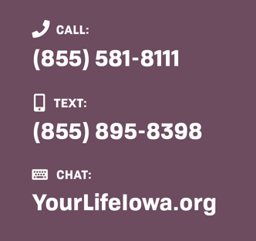
What is Your Life Iowa?
Available 24/7/365.
Information, Resources, Referrals and Help around alcohol, drugs, gambling, mental health, thoughts of suicide and related concerns.
Access to behavioral health system navigation
Website: yourlifeiowa.org
Supportive Text Messaging: yourlifeiowa.support
Help is offered by experts in the field dedicated to the health of Iowans.
Notes:
Your Life Iowa (YLI) is funded by the Iowa Department of Health and Human Services (Iowa HHS) and supports the Iowa HHS mission by providing high quality services that protect and improve the health and resiliency of individuals, families and communities , and uniquely tailoring our efforts to advance optimal and equitable health outcomes for all Iowans.
YLI is the trusted 24/7 resource for all Iowans when they have a question or concern about gambling, mental health, substance use or suicidal thoughts or other related concerns.
YLI is a beacon of hope. YLI respects the courage taken to reach out, no judgement, just help. YLI is committed to normalizing social perceptions and reducing the societal stigma towards gambling, mental health, substance use and suicide.
Launched in October 2017 for gambling, substance use and suicide prevention and expanded in December 2019 to include Adult and Children’s Mental Health, Your Life Iowa is the result of three distinct projects, their websites and helplines, being integrated into the YLI project. The three projects were:
Problem Gambling: 1-800-BETS OFF helpline and 1800BETSOFF.org, including online chat function
Alcohol/Drug use: DrugFreeInfo.org and help line (866-242-4111)
Suicide and Bullying Prevention: Helpline (855-581-8111), Text Line (855-898-8398) and yourlifeiowa.org with online chat feature

Slide 4
What is Your Life Iowa?
Where it began . . .
Population estimates (18 and Older)
Iowans 18+
2.2M
Concerned Friends and Family
In Need or At Risk
Helped
Gambling
46% of adults gamble regularly (past 30 days)
14% at risk (315,000)
1% problem
Alcohol Use
63.2% use in past month
Alcohol Use Disorder 7.2%
Binge use in past month 30.8%
7% needed treatment but did not receive
Other Substance Use
7.2% used Marijuana in the past month
9.1% Substance Use Disorder
8.3% needed treatment but did not receive
Mental Health
19% (18 and older) Any mental illness in the past year
8.7% experience a major depressive episode in the past year
5.4% had serious thoughts of suicide
53.6% with any mental illness that received care
Suicide Rate (2023) approximately 16 per 100K Iowans
Death by Suicide (CY 2023): 509
  Down from CY 2022 (599) and first drop in death by suicide from previous year since CY 2000
  CY 2024 is trending higher than CY 2023
Overlap in substance abuse + mental health
50% who experience mental illness also experience problems with substance use.
Source: NSDUH , Gambling Attitudes and Behaviors - IDPH, Iowa Health Tracking Portal, Behavioral Health Barometer, Iowa, Volume 5. Public
Notes:
You can see from the data on this slide (feel free to reference some of the data points) many adult Iowans 18 and older have been impacted by either gambling, mental health, substance use, suicide, or a combination.
Do any of these data points surprise you? Which ones? What stands out to you?
YLI is committed to continue to grow the “Helped” part of the circle and help remove any of the barriers to accessing behavioral health or related care and support.
No matter the complexity, Your Life is here to help, 24/7. Help is always just a phone, text, chat away.

Slide 5




Have you heard of Your Life Iowa?
Yes
No
Source: Your Life Iowa Qualitative Research 2019, conducted by ZLR Ignition + Vera Causa
Notes:
Research was conducted by IDPH back in 2019 to assess relevance, awareness and overall appeal of using YLI to access information and support resources.
Research revealed the following key learnings and validated the value of YLI. When faced with an alcohol, drug, gambling, suicide or related concern, individuals and their families don’t know where to start to seek help. They often feel like they’re alone on getting help and that people don’t care.
Some of the suggestions we heard to overcome the barriers or challenges to accessing help included:
Create a one-stop resource that’s simple and easy to access
Increase awareness of the opportunities/tools to get help
Reduce stigma/discuss topics/normalize these problems so more and more people can come forward without feeling shame
Be aware these issues are often intertwined and individuals seeking help may be struggling with more than one issue
YLI has been committed to addressing these recommendations, by being the go-to resource for individuals and their families to access when they or loved ones are struggling with gambling, mental health, substance use, or suicidal thoughts.

Slide 6
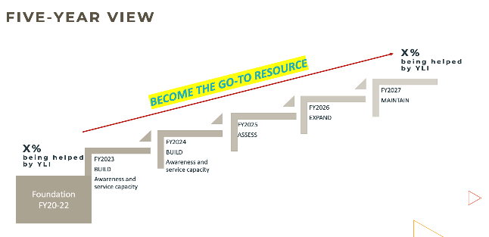
What is Your Life Iowa?
Mission & Vision
Mission:
Be the go-to resource for Iowans seeking information or help for gambling, mental health, substance use, suicide or related concerns.
Vision:
Connecting services and support to Iowans and promoting healing and wellbeing.
Notes:
As YLI has grown up, a sense of mission and vision has developed as part of YLI’s indentity.
Mission:
Be the go-to resource for Iowans seeking information or help for gambling, mental health, substance use, suicide or related concerns.
Vision:
Connecting services and support to Iowans and promoting healing and wellbeing.
While only about 7% of the original focus group participants had heard of YLI back in 2019, they overwhelming endorsed Your Life Iowa concept of a single place where Iowans can turn to when facing a problem with substance use, gambling, mental health, suicide and more. We continue to make progress (you’ll see some data coming up soon!). The numbers grow each year, and your help is needed, as you may never know who you might meet or be in conversation with, and you can provide information about Your Life Iowa, and potentially, change a life. As part of YLI’s Strategic Foundation, our goal by 2027 is that 85% of Iowans will be aware of YLI and know they can reach out for the help or information they seek.

Slide 7
What is Your Life Iowa?
YLI Pillars
Judgement Free
Your problem is our problem.
You’re Not Alone
Many Iowans, including us, face these same challenges every day.
Guide to Better Health
We offer the information, support and guidance to help Iowans get their life back to a good place
We want to make sure you’re put on the right path to have a successful future.
That’s why we leave our judgment at the door. It makes it easier to help put you on the right path to recovery.
We know it’s hard but when you have someone with you every step of the way it helps.
We’re here when you’re tempted, struggling, or want someone to listen.
Notes:
During the initial focus group sessions YLI conducted in 2019, several key barriers were identified by participants to accessing help:
Did not know where to start to get help
Feared being judged or shamed
Did not recognize a resource for help that is top-of-mind (outside of 1-800-BETS OFF)
They often struggled with more than one issue or concern
In response to this feedback, the YLI team created three core messages that have become the foundation of the work YLI does.
Judgment Free We want to make sure you’re put on the right path to have a successful future. That’s why we leave our judgment at the door. It makes it easier to help put you on the right path to recovery.
You’re Not Alone We know it can be hard to reach out, but when you have someone there for you every step of the way it helps. Many of us face the same challenges every day. When you’re struggling. We’re here. When you’re tempted. We’re here. When you just need someone to talk to. We’re always here.
Guide to Better Health Having access to a one-stop resource for information, care and support is important to healthy living. It's important to YLI too. We'll walk beside you, providing tools, guidance and hope for better health.

Slide 8
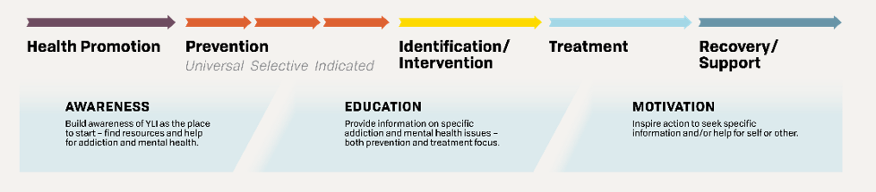
What is Your Life Iowa?
YLI & the Care Continuum
Notes:
YLI aims to serve all Iowans no matter where they might fall on the care continuum. Whether raising awareness of Your Life Iowa or providing target messaging. Whether it’s addressing adult and children’s mental health, or the importance of asking a friend who might be contemplating thoughts of hurting themselves or others. Or whether it is providing parents, healthcare providers, and employers with tools to assist Iowans being impacted by their or someone else's substance use, gambling, or mental health related behaviors.
Then there are those Iowans who have identified they want help, and then YLI quickly linking them to services. Or it could be an individual who is in care or in recovery and desires to touch base with a supportive person.
It’s been important to YLI to make sure they develop targeted messaging to ensure YLI is effectively providing information, resources and help, to each segment of the continuum. So, no matter where an Iowan might be on the continuum, YLI is there to help.

Slide 9



What to expect when you contact YLI
https://youtu.be/AoklqgaqV_M
Notes:
Many people ask, “So what happens when I call, text or chat to YLI?” Well, YLI created a short video that helps explain what happens. You can find the video at the YLI website, yourlifeiowa.org.
<Here’s the script for the video to read, if the video does not play>
We know reaching out to Your Life Iowa for a concern with alcohol, drugs, gambling, mental health or suicidal thoughts can be hard. But our hope is that once you know what to expect when you contact us, you’ll see there’s nothing to be nervous about.
This is Emily. She has a problem that’s been keeping her up at night, but she wasn’t sure who to turn to. Until she found Your Life Iowa.
When Emily calls, she’s connected to Tammy, one of Your Life Iowa’s compassionate counselors. Tammy lets Emily know she’s here for her and can connect her to help. Tammy’s role is to listen and offer confidential and immediate support without any form of judgment.
Soon, Emily talks to Tammy openly and honestly about her concerns. Tammy lets her know that what she is experiencing is common and, based on what Emily is experiencing, Tammy offers a variety of support. Like “in-the-moment” crisis counseling, information, or connecting her to nearby help.
Together, Emily and Tammy come up with the next steps that Emily will take.
Already, Emily’s starting to feel supported and less alone. After just one phone call because she now knows she can call again at any time.
Prefer to text or live chat? We offer those options, too. When you text or chat with us online, you’ll connect to a counselor who can offer immediate crisis counseling, support or connect you to nearby help.
No matter how you connect with Your Life Iowa, one thing’s the same – you can find support for whatever challenge you’re facing. No judging. Just helping.
When you are ready, we are here for you. You can call us, text us or chat with us online. 24 hours a day, 7 days a week. We’re your everyday life support.

Slide 10
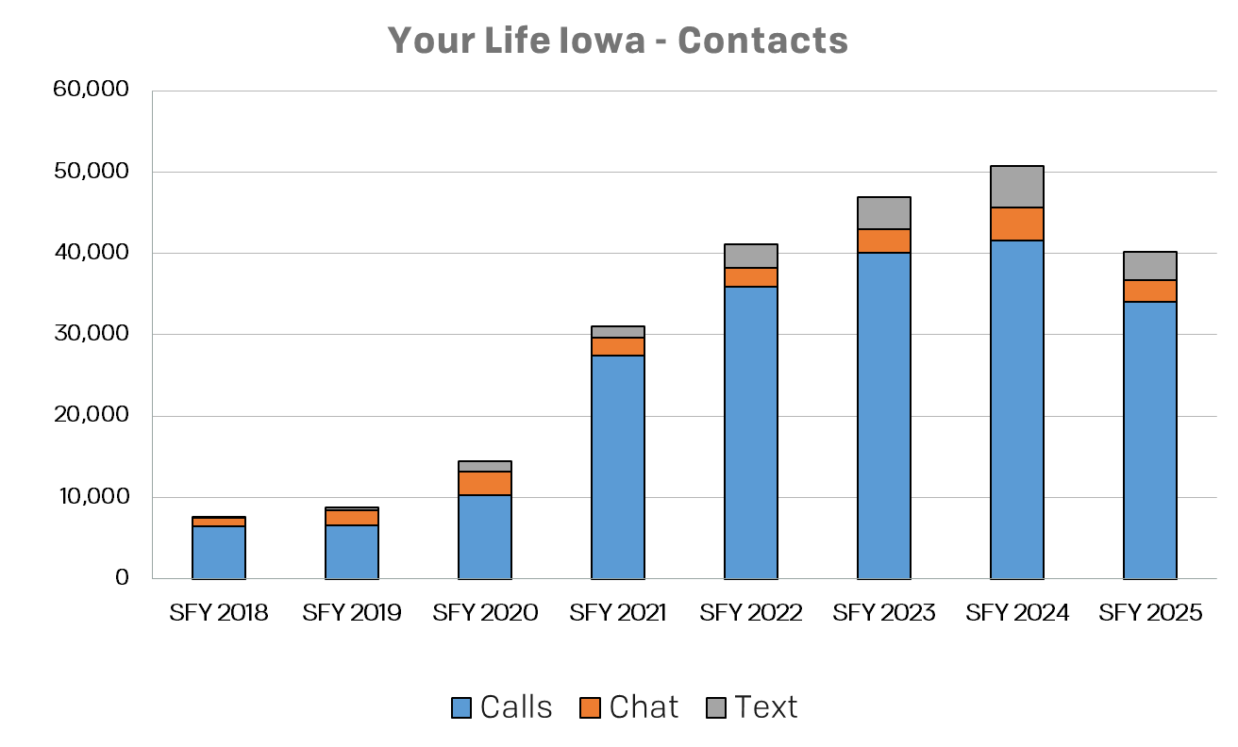
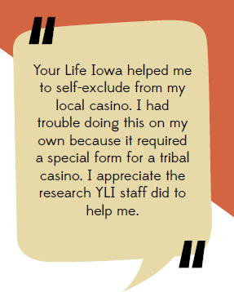
Trends . . .
Notes:
The utilization of YLI has grown steadily, as you can see on this chart. In SFY 2024, almost 51,000 contacts (phone, text, chat) were made to Your Life Iowa, more than a six-fold increase since SFY 2018. We saw a decline in contacts to YLI in SFY 2025. We expect an increase for SFY 2026 with YLI now being the “brightly lit front door” to access behavioral health services and system navigation, which will talk on a bit later.

Slide 11
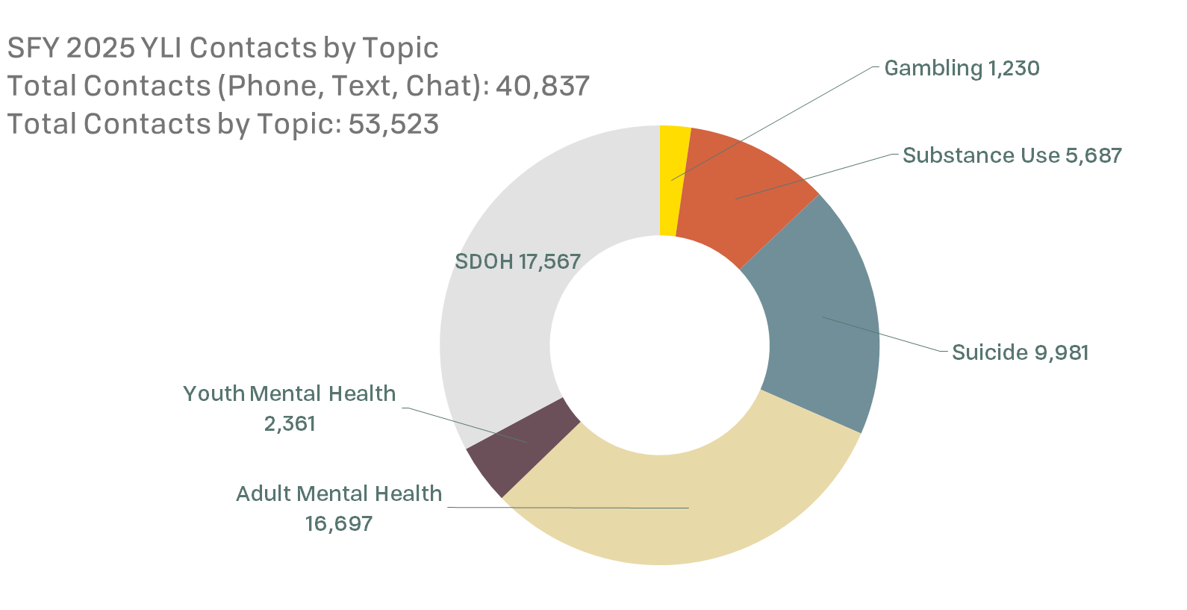
Trends . . .
Notes:
Most of the time when someone contacts YLI, more than one thing is going on their lives that they are seeking help for. As you can see from the numbers, social determinants of health also play a role from basic needs (housing, food, physical health), family/interpersonal relationship concerns, sexual assault, workforce, loss/grief, family/elder concerns, natural disaster and world events, all come into play as well.

Slide 12
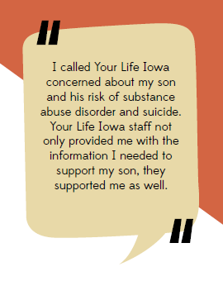
More Trends . . .
Notes:
The YLI website, yourlifeiowa.org, since July of 2017 has recorded almost 3.3 million visits by 2.2 million users.
The YLI website and concept has become a model for other states to mimic a “one stop shop” for behavioral health.

Slide 13
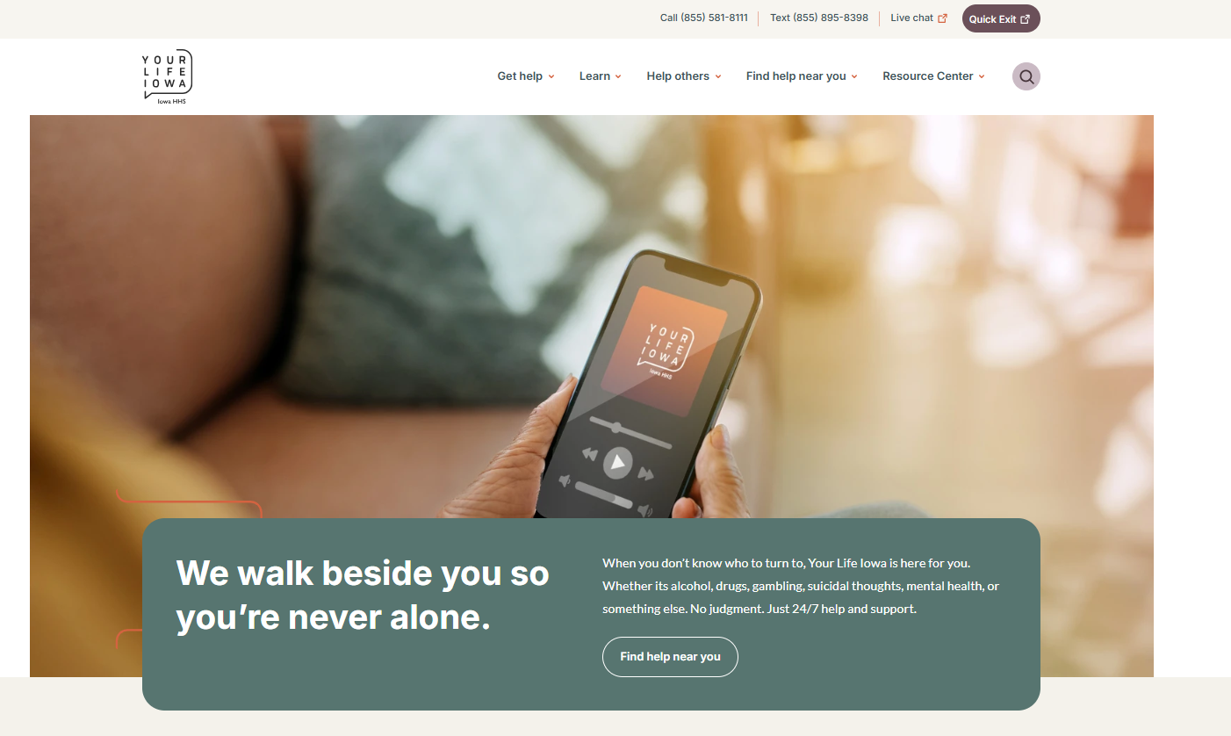
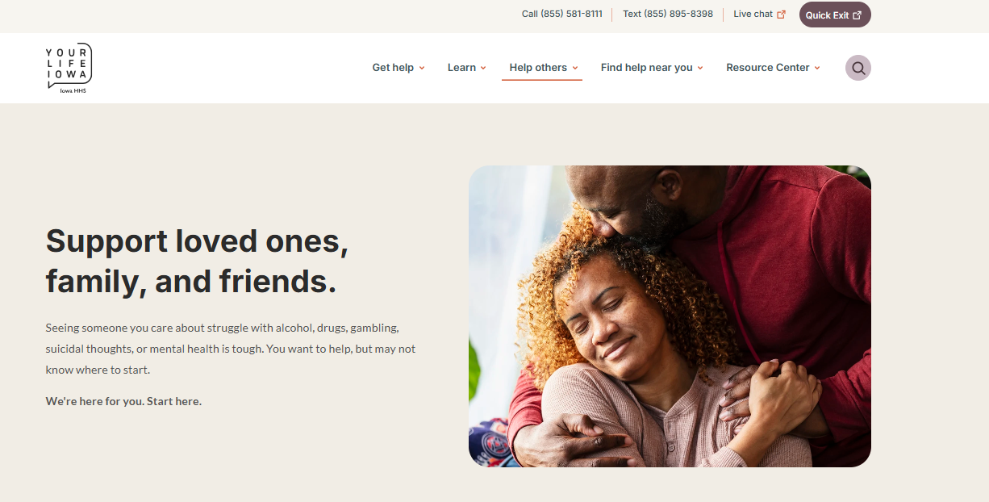
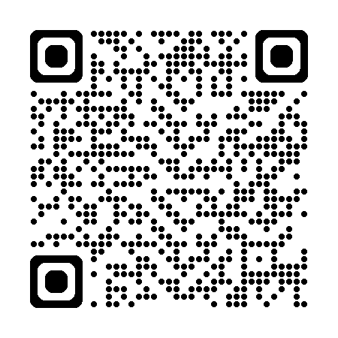
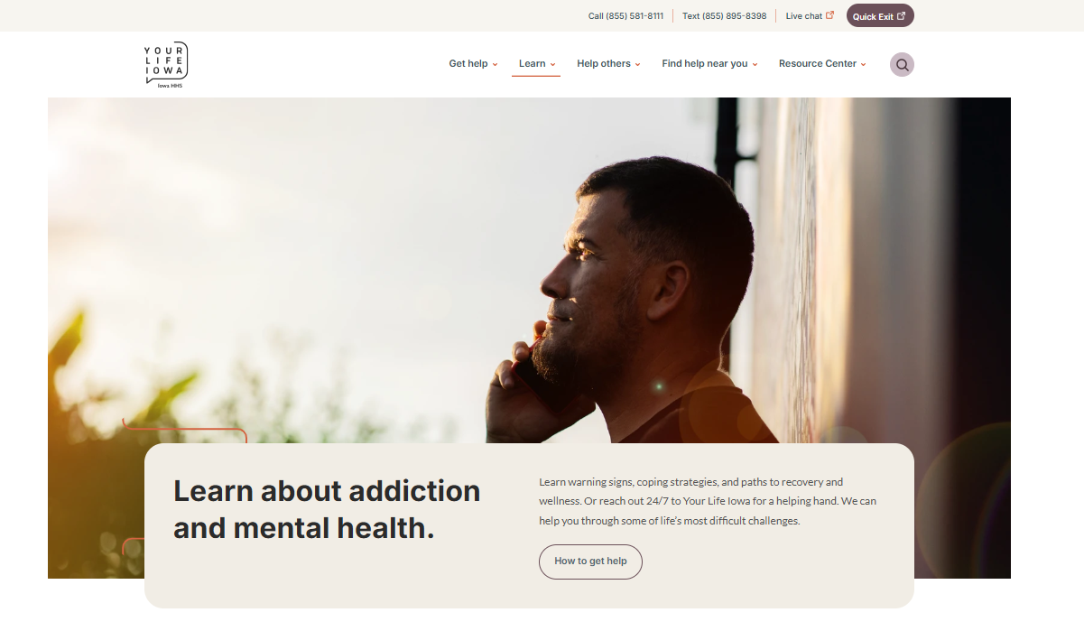
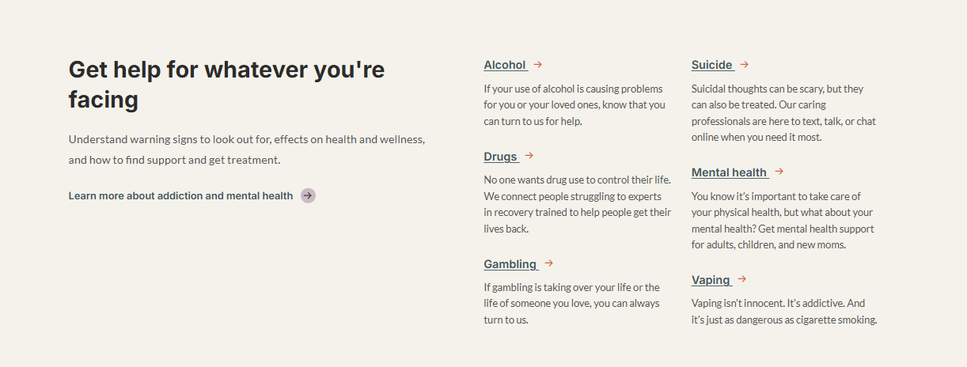
Your Life Iowa Website
https://yourlifeiowa.org
Notes:
YourLifeiowa.org is a website offering Iowans easy access to reliable information, resources and treatment options for gambling, mental health, substance use, suicide and related concerns. The website content, including calls to action, pictures, text and messaging were intentionally chosen to show trust, professionalism, respect and sensitivity, while providing helpful, quality and clear information. During SFY 2024, over 211,000 Iowans recorded almost 353,000 visits (sessions) to the website. Also, each month 185 individuals received motivational and supportive text messages each month at https://yourlifeiowa.support. Almost 45,000 motivational texts were sent during the year.
Feedback is always welcomed and can be provided via yli@idph.iowa.gov, or using the contact form found at https://yourlifeiowa.org/contact. HHS and the YLI team is currently working on the next rendition of the website. Look for announcements in the summer of 2025!

Slide 14
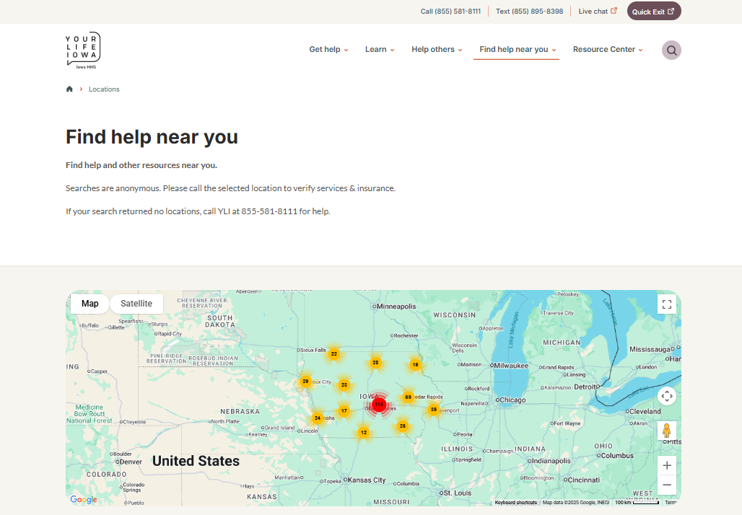
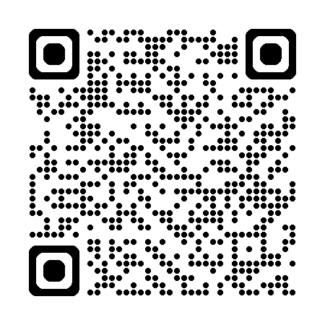
Find Help Near You Locator
https://yourlifeiowa.org/locations
Notes:
Connecting with help in your community is now simpler than ever! The YLI Find Help Near You locator is free, confidential and available 24/7. Its now aasy for Iowans to find the support they need—whenever they need it.
The Find Help Near you is a searchable database featuring hundreds of Iowa-based providers specializing in substance use and mental health care. You can filter results by location, type of service, age group and payment assistance options, ensuring you find the right support for your situation
Services Available in the Locator:
Drinking driver education programs
Prevention programs
Substance use and gambling disorder treatment programs
Mental health providers, including CMHCs, CCBHCs
Recovery Community Organizations
Peer Recovery Organizations
Opioid treatment programs
Medication therapy
In addition to connecting you with care, the locator also provides educational resources on seeking help, understanding addiction and finding additional support. If you're a service provider and would like to be listed, you can fill out the YLI Contact Form and a YLI team member will walk you through the process.

Slide 15
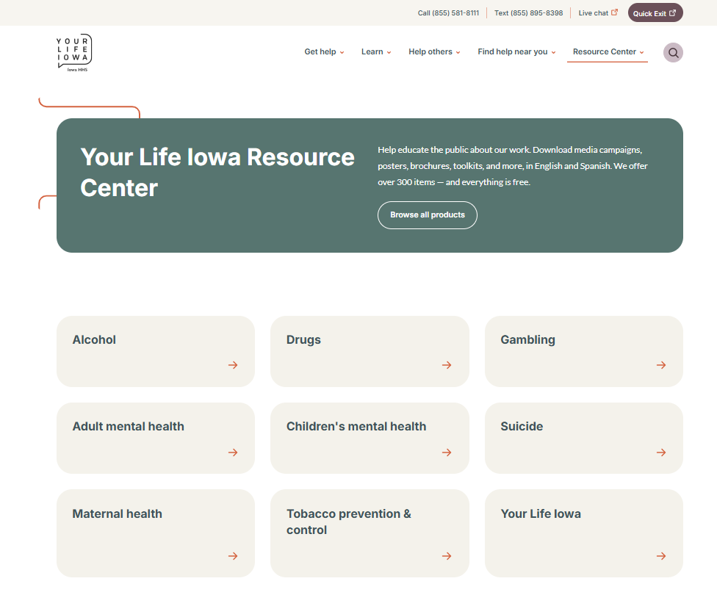
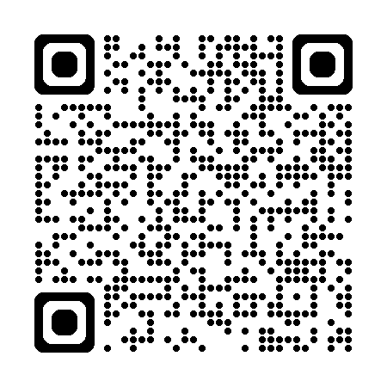
YLI Resource Center
Contains over 300+ items (including 30+ Spanish items).
All items on the Your Life Iowa Resource Center are free.
  Media Campaign Items | Banner ads, Billboards, Campaign Overviews, Cards, Flyers, Posters, Print ads, Radio and TV spots, Social media
  Other items | Brochures, Business Cards, Magnets, Toolkits, Workbooks
Search by topic.
Search for Radio and TV spots.
Digital and “print-ready” files are available for download.
Some items are available for ordering and free shipping.
https://yourlifeiowa.org/resource-center
Notes:
The new Your Life Iowa Resource Center (https://yourlifeiowa.org/resource-center/home) has over 350+ items (including 30+ Spanish items) to assist efforts to educate and inform the public. There is also a helpful tutorial on how to use the YLI Resource Center.
All items on the Your Life Iowa Resource Center are free. You'll find the following items available for personal and professional use:
Media Campaign Items:
Banner ads
Billboards
Campaign Overviews
Flyers
Posters
Radio and TV spots
Social media
Other items:
Brochures
Business Card
Magnets
Toolkits
Digital and “print-ready” files are available for download. Some items are available for ordering and free shipping.

Slide 16

Miquel’s Story
Miquel* called Your Life Iowa one evening and reported having thoughts of suicide. The caller had been consuming alcohol as well which had not helped him to feel better. During the suicide screening, Miquel endorsed two specific plans but indicated he did not truly want to die and wanted help. He was tearful throughout the call. The YLI counselor who answered the call, provided support and compassion while assessing for immediate risk of harm to self. The YLI counselor explained and offered to have Mobile Crisis Outreach (MCO) respond to better provide some in-person support to the caller (and also to help mitigate the risk of suicide that was evident). The caller accepted this offer and indicated he could keep himself safe until MCO arrived, and additional safety plan components were put into place.
*Not their real name

Slide 17

988 | Suicide & Crisis Lifeline
Free and confidential 24/7 emotional support to people in suicidal crisis or emotional distress.
National network of over 200 local crisis centers.
Trained crisis counselors who support individuals considering/experiencing:
  Suicide.
  Self-harm.
  Emotional distress.
  People looking for help for someone experiencing a crisis.
Iowa’s statewide Crisis Line
  Mobile Crisis Response
Notes:
The 988 Suicide & Crisis Lifeline launch in July 2022 and has seen their phone and text volume increase since the launch. Between YLI and 988 about 300 contacts are made every day for help for behavioral health related concerns. Foundation 2 and CommUnity are the 988 Crisis Centers in Iowa that answer the 988 phone, text and chat lines. One of the advantages of the 988 system in Iowa, is that if a call, text or chat to 988 is not able to be answered by Iowa’s two call centers, the contact is routed to a national back up, assuring that every call will get responded to. At Foundation 2, the YLI call center, the counselors that answer YLI, also answer 988 and vice versa. This ensures Iowa has the capacity to respond to each contact. Our goal is that 100% of the YLI and 988 calls, text and chats are answered right here in Iowa. As of July 1, 2025, 988 is now Iowa’s statewide crisis line and access to mobile crisis response.

Slide 18
System Navigation, Access to Care & Stigma

Slide 19

What is System Navigation?
Having concerns about gambling, mental health, substance use, or tobacco use?
Whether it's you or someone you love, it can be hard to know where to turn for help.
That’s where Your Life Iowa comes in.
Talk to a Behavioral Health System Navigator—for free.
System Navigators are professionals trained and have a passion to:
Listen and learn about your needs
Connect you to the right care and support near you
Help you find services to assist with basic needs, housing, employment, financial issues
System Navigators do not provide treatment—but they help you find someone who does.
Notes:
When you or someone you care about is struggling, it can be hard to find support. In July 2025, a new behavioral health system service is now available for free to all Iowans. It’s called System Navigation.
Your Life Iowa is your access point to work with a Behavioral Health System Navigator who will help you quickly find the services that can help you.
What is Behavioral Health? “Behavioral health” means mental health, and addictive disorders like gambling and substance use, including tobacco and nicotine.
What does a System Navigator do? System Navigators are trained to help you find the right behavioral health care and services. They give free, private support to all Iowans.
When you contact Your Life Iowa, a System Navigator can:
Talk with you on the phone or help you online.
Listen and learn about your needs.
Connect you with providers who can get you the right care.
Find inpatient psychiatric care beds or crisis care services, if needed.
Find services to help you with money, housing or job problems.
System Navigators do not give treatment, medicine, or counseling. Instead, your System Navigator will help you find the right people who offer the services you need.

Slide 20




Behavioral Health System Navigation
Brightly Lit Front Door
For Patients, Supporters, and Caregivers
  Call: 855-581-8111
  Text: 855-895-8398
  Chat: yourlifeiowa.org
Notes:
Brightly lit front door; all Iowans call Your Life Iowa; and other entities listed on the right will have a direct line to system navigators via System Navigation Line which will be available on our website

Slide 21
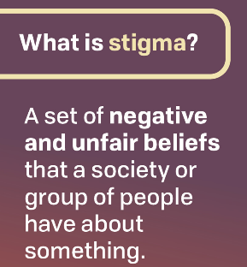
Barriers to accessing care
Not knowing where to go, what to do, where to start/ confused/ overwhelmed
Shame; fear of being judged/ appearing unsuccessful or weak
Feel alone and isolated/ nobody cares
Money/ intimidated by potential costs involved
Too many other responsibilities, commitments, and pressure/ lack of time
Seems too hard/ feels insurmountable
Not trusting people
Notes:
It’s likely you know someone who has a behavioral health condition, even if you don’t realize it. That’s why it’s important we’re careful with the words we choos. Language can further the stigma around behavioral health conditions and even affect how people get care. From the research conducted back in 2019, Iowans told us about the barriers to accessing help for themselves or a family member or friend. How do you think the words we use may impact or be behind the reasons listed here? Can you put yourself in each of these situations? Gambling? Substance Use? Mental Health? Tobacco/Nicotine? What stands out? What comes to mind?

Slide 22

Stigma
Stigma is discrimination against an identifiable group of people, a place, or a nation.
Stigma is associated with a lack of knowledge, a need to blame someone, fears about disease and death, and gossip that spreads rumors and myths.
Stigma hurts everyone by creating more fear or anger toward ordinary people instead of focusing on the disease that is causing the problem.
Stigma can make people more likely to hide symptoms or illness, keep them from seeking care immediately, and prevent individuals from adopting healthier behaviors.
Notes:
What is stigma?
Stigma is a set of negative beliefs and stereotypes about people that belong to a specific group.
Stigma can lead to shame and discriminatory behavior.
There are three main types of stigma:
Public/Social – The negative attitudes and beliefs others have for a group of people.
Structural – Policies that restrict (intentionally or not) the opportunities of targeted groups.
Self – This happens when people start believing the negative stereotypes, they hear about themselves. It increases shame and reduces self-worth.

Slide 23
Stigma | Iowa
Iowa residents are more stigmatizing of Opioid Use Disorders (OUD) than the US population.
Surveyed Iowans report less willingness to interact with people with OUD in neighborhoods, as friends, and at work, compared to national averages.
On a scale from 1 (lowest stigma) to 4 (highest stigma), Iowa’s scale scores for public stigma and structural stigma were higher than the national average scale scores. However, Iowa’s average scale scores for self-stigma and Medication for OUD (MOUD) stigma were lower than the national average.
Iowans hold more stigmatizing (compared to the national average) views as it relates to hiring or having someone who is actively using an opioid as a supervisor or co-worker.
Notes:
Why does stigma matter?
Stigma matters because it places blame on a person. This can make it hard for others to understand the complex factors related to substance use. It’s one of the biggest barriers for people who use substances to get the care they need and deserve.
Here’s some statements from 2022 when Shatterproof came to Iowa to find out how Iowans have been impacted by Stigma.

Slide 24
Person first language
Recommended Language to Use | Stigmatizing Language to Avoid or Use with Caution | Why?
Substance Use | Substance Abuse | The term "abuse" is associated with criminal activity (i.e., domestic abuse, child abuse).
Person with substance use disorder or challenge | Addict, Junkie, Abuser, Druggie, User | People cannot and should not be defined by one behavior or characteristic. The person should always come first to avoid stereotypes and stigma. "Substance use disorder" should not be used interchangeable with "substance use." Not everyone who uses substances has a substance use disorder.
Person with alcohol use disorder | Alcoholic, Drunk | People cannot and should not be defined by one behavior or characteristic. The person should always come first to avoid stereotypes and stigma. "Substance use disorder" should not be used interchangeable with "substance use." Not everyone who uses substances has a substance use disorder.
Substance free | No longer using _____ | Clean | The terms “dirty” and “clean” are adjectives used to describe filth or the lack thereof. They further negative stereotypes.
Notes:
It’s likely we all know or interact with someone who has a behavioral health situation. When looking at substance use specifically, about 50% of know someone who uses substances or has a substance use disorder. This means our words when in conversation with a friend or family member may unknowingly affect someone we know and care about. In fact, the Iowa Baseline Stigma Survey in 2022 showed over half of survey participants knew someone with an opioid use disorder (OUD). Words matter when it comes to speaking about substance use.
Why do words matter?
Research shows that using negative labels and stereotypes hurts people who have substance use disorder by furthering the stigma around the disorder.
What is person-first language?
Person first language focuses on the whole person rather than their behavior or condition. It respects the value and dignity of people by placing them before their condition. This type of language helps break down stereotypes, fosters understanding and promotes a more inclusive and supportive environment for people who use substances.

Slide 25
Person first language
Recommended Language to Use | Stigmatizing Language to Avoid or Use with Caution | Why?
For illicit drugs: Using _____ substance For prescription medication: Misusing ______ substance; used other than prescribed | Abuse, Drug of choice Habit | The term “abuse” is associated with criminal activity (i.e., domestic abuse, child abuse). People who use substances are not inherently criminals. “Drug of choice” or “habit” implies that a person chooses to have a substance use disorder.
Testing negative/positive for substance use | Clean/Dirty | The terms “dirty” and “clean” are adjectives used to describe filth or the lack thereof. They further negative stereotypes.
Resumed or experience a recurrence of substance use or substance use disorder symptoms | Relapse/Slip | The terms “relapse” and “slip” do not accurately represent a person’s pathway to self-defined recovery and places blame on the individual rather than the disease.
Well, Healthy In recovery | Sober | The term “sober” implies a person is not under the influence of any substance. However, people self-define their own recovery and do not have to abstain from all substances to be healthy and well.
Notes:
Should everyone use person-first language?
Yes. This includes us, family members, community members, healthcare and service providers, law enforcement, employers and people in the media
What are other labels that you hear everyday? How do you feel about these labels? If I say “alcoholic”, what comes to mind? If I say, “I’m a person in long term recovery from alcohol use”, what comes to mind?

Slide 26
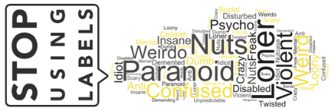
Reducing Stigma
What can we do? | Part 1
Know the facts. Educate yourself about behavioral health.
Beware of your own attitudes and behavior. Examine your own judgmental thinking. Reinforced by your upbringing and society.
Choose your words carefully. The way we speak can affect the attitudes of others.
Educate others. Pass on the facts and positive attitudes; challenge myths and stereotypes.
Notes:
What can you do?
Use person-first language in all communications.
Stay informed about best practices. Accepted language can change over time.
Review organizational or personal materials and remove any stigmatizing language.
Learn person-first language and model changes in front of others.
Review all organizational communications including forms, presentations, brochures, etc. to ensure person-first language is used.
Stay informed and up-to-date about best practices related to language. Accepted language can change over time.
Remove stigmatizing language or imagery from materials - from presentations to intake forms.
Ask questions and be curious.
People who use or used substances may use what would be considered stigmatizing language in certain situations. (Example: In 12-step meetings, the term addict or alcoholic may be used to introduce oneself.)⁴
Respect people’s right to self-identity within their comfort zone and ask how you can support them.

Slide 27
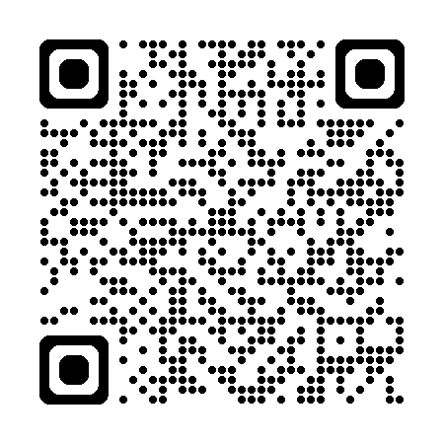
Reducing Stigma
What can we do? | Part 2
Focus on the positive. Behavioral health status is only part of anyone’s larger picture.
Support people. Treat everyone with dignity and respect; offer support and encouragement.
Include everyone. It’s against the law to deny jobs or services to anyone.
Learn more about stigma at https://yourlifeiowa.org/learn/stigma
Notes:
Pause before sharing.
Some materials and media resources use stigmatizing language.
Be sure to review materials before sharing with others to avoid causing any harm.
Be open to respectfully correcting yourself and others.
Ensure clear language.
Ensure the language you use is clear and accurate.
Respect a person’s right to self-identify within their comfort zone and learn ways you can support them.

Slide 28

The Potential
We can accomplish great things with a coordinated effort!
Saving one life at a time.
Becoming the place where people turn to when they need help.
Educating the community about these challenges and normalizing them to reduce the stigma.
Uplift people who seek services and walk with them until engaged in services.
Help facilitate change to remove barriers to accessing care and recovery pathways.
Notes:
YLI has embarked is in the middle of a five-year initiative to expand the YLI brand awareness across Iowa and increase the number Iowans seeking and accessing information and care for substance use, gambling, mental health and suicide. This deliberate approach and the corresponding operational activities outlines the effort that will be needed to achieve the operational goals and proposed growth in awareness and corresponding services with a bold goal of achieving 85% unaided brand awareness of Iowans and 85% engagement of those referred to services.
The potential is out before use. We can accomplish great things with a coordinated effort, to increase access to and the availability of care for substance use, gambling, mental health, suicide and more. Educating on and normalizing social views and uplift those who seek services and walk with them till they engage in services. Let’s continue to facilitate change to remove barriers that Iowans experience in accessing and engaging in care; and making sure we support Iowans across the entire care continuum.

Slide 29

YLI | A simple idea has helped thousands!
Media Center (2019)
YLI becomes the Statewide Crisis Line (2020)
Medication Assisted Recovery added to Facility Locator (2020)
Brain Injury screening/information (2021)
YLI Project Director Position created/filled (2021)
New YLI Resource Center (2023)
YLI Apparel Store (2023)
  https://crgearhub.com/YLI/shop/home
Stigma Reduction Education and Resources (2024)
Maternal Health (2024)
New Find Help Near You Locator (2025)
New YLI website (July 2025)
Notes:
YLI is here for you. The feedback received about experience using YLI help inform next steps. As you can see from the list, there have been some great ideas that came to the YLI team that they were able to make happen. And now the YLI team has launched a new version of the website to better serve Iowans. Visit yourlifeiowa.org and take it for a test ride and let use know what you think! Your feedback has been what has shaped YLI to what it is today!

Slide 30

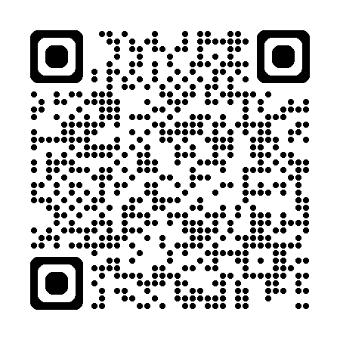
What’s Next?
Brainstorming for the future. . .
Comments, feedback and suggestions are always welcomed!
Want to get in on the latest YLI information and updates?
  Subscribe the YLI List Serve
How can YLI help?
How can you help YLI?
Subscribe the YLI List Serve
Notes:
Feedback and ideas are always welcomed by YLI! It’s how we continue improve and better serve Iowans. If you have feedback, use the Contact Us form on the YLI website or email YLI at YLI@hhs.iowa.gov. Let us know how we can help! Let us know how you can help! If you’d like a YLI presentation to a group in your community, you can reach out using the Contact Us form on the YLI website, or YLI@hhs.iowa.gov.
If you’d like to be kept up to date on YLI happenings, you can scan the QR code on the screen to sign up to be on the YLI list serve.

Slide 31
Questions?

Slide 32
Thank You!
[Your Name]
[Your Company Name]
[email address]
yli@hhs.iowa.gov
Notes:
Thank you again for the opportunity to be with you today. I hope that each of you will take something away from the presentation to help you with your overall wellbeing and relationships at school and home. Here’s is my contact information if you’d lie to get a hold of me, as well as the contact information for YLI. Thank you!

Slide 33
Final bumper

