Slide 1

Your Life Iowa & Student Wellness
<ENTER LOCATION HERE>
<ENTER DATE HERE>

Slide 2
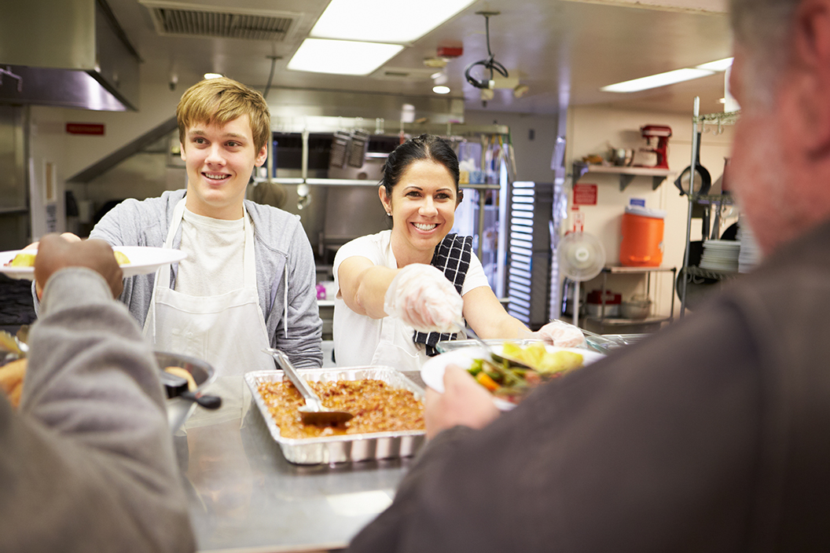
YLI & Student Wellness
Welcome!
Description
This presentation will introduce Your Life Iowa and the Student ID program, general concepts of wellness; and, how Your Life Iowa can support student wellness.
Goals
Together we will explore:
What is Your Life Iowa (YLI) & HF 602 (Student IDs)
Student Wellness & Checking our Talk
How YLI can help!
Notes:
NOTES to the Presenter:
Introduce yourself and what you do to the audience.
Maybe ask them how many have heard of YLI? Generally about 25-50% of individuals have heard, sometimes less, sometimes more. What is important that they know that YLI is here for each and everyone of them. Life eventually will go sideways for most of us, and YLI is here to help.
If a smaller group, you could do an icebreaker activity
The following slides are scripted, but feel free to add your own experiences and how you’ve used YLI, if appropriate for the audience.

Slide 3
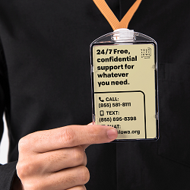
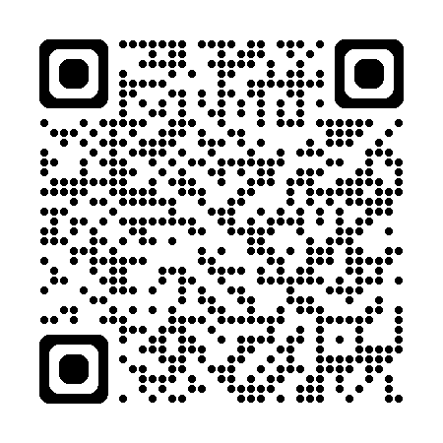
House File 602
Student ID Requirement
Requires student identification cards to include the contact information for Your Life Iowa or any successor program.
Applicable for all student ID cards issued after July 1, 2023, statewide for students in grades 7-12.
The inclusion of this information is optional for identification cards issued to students in grades 5 and 6.
https://yourlifeiowa.org/student-id
Notes:
House File 602 was signed into law by Governor Kim Reynolds in June 2023 and went into effect on July 1, 2023. The bill requires student identification cards to include the contact information for Your Life Iowa or any successor program. This is applicable for all student ID cards issued after July 1, 2023, statewide for students in grades 7-12. The inclusion of this information is optional for identification cards issued to students in grades 5 and 6.

Slide 4
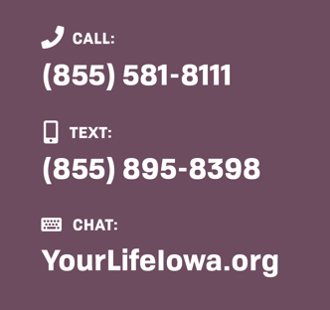
What is Your Life Iowa?
Available 24/7/365.
Information, Resources, Referrals and Help around alcohol, drugs, gambling, mental health, thoughts of suicide and related concerns.
Website: yourlifeiowa.org
Supportive Text Messaging: yourlifeiowa.support
Help is offered by experts in the field dedicated to the health of Iowans.
Notes:
Your Life Iowa (YLI) is funded by the Iowa Department of Health and Human Services (Iowa HHS), and supports the Iowa HHS mission by providing high quality services that protect and improve the health and resiliency of individuals, families and communities , and uniquely tailoring our efforts to advance optimal and equitable health outcomes for all Iowans.
YLI is the trusted 24/7 resource for all Iowans when they have a question or concern about gambling, mental health, substance use or suicidal thoughts or other related concerns.
YLI is a beacon of hope. YLI respects the courage taken to reach out, no judgement, just help. YLI is committed to normalizing social perceptions and reducing the societal stigma towards gambling, mental health, substance use and suicide.

Slide 5
Your Life Iowa Pillars
Judgement Free
Your problem is our problem.
You’re Not Alone
Many Iowans, including us, face these same challenges every day.
Guide to Better Health
We offer the information, support and guidance to help Iowans get their life back to a good place
We want to make sure you’re put on the right path to a successful future.
We leave our judgment at the door.
When you have someone with you every step of the way, it helps.
We’re here when you’re sober, tempted, or struggling.
Notes:
During the initial focus group sessions, key barriers were identified by participants to accessing help:
Did not know where to start to get help
Feared being judged or shamed
Did not recognize a resource for help that is top-of-mind (outside of 1-800-BETS OFF)
They often struggled with more than one issue or concern
In response, three core messages were developed, that have become the foundational
Judgment Free We want to make sure you’re put on the right path to have a successful future. That’s why we leave our judgment at the door. It makes it easier to help put you on the right path to recovery.
You’re Not Alone We know it can be hard to reach out, but when you have someone there for you every step of the way it helps. Many of us face the same challenges every day. When you’re struggling. We’re here. When you’re tempted. We’re here. When you just need someone to talk to. We’re always here.
Guide to Better Health Having access to a one-stop resource for information, care and support is important to healthy living. It's important to YLI too. We'll walk beside you, providing tools, guidance and hope for better health.

Slide 6
Your Life Iowa Contacts
SFY 2024 | 17 and Younger
2,758 Total Contacts
79% | Mental Health
57% | Social Determinants of Health
52% | Suicide Concern
5% | Substance Concern
Less than 1% | Gambling
79% | More than 1 concern
Notes:
In SFY 2024, of those who reported their age, 2,732 of the 50,785 contacts made with YLI, were for those individuals 17 and younger. This is over a 300% increase compared to SFY 2023 (710). For SFY 2024 those 17 and under who reach out, did so an average of 3.3 times. In 79% of the contacts, individuals 17 and under were reporting more than one concern when they made contact with YLI.
Over on the pie, you’ll see the total contacts and total contacts by topic. You’ll see Mental Health was number one, followed by "Other“, which is our Social Determinants of Health category that includes reported concerns like Assault, Basic Needs, Child Abuse, Contract Call, Domestic Violence, Elder Concerns, Family Relationships, Financial/Job, Interpersonal Relationships, Loss/Grief, Natural Disaster, Ongoing Support, Physical Health, School, Sexual Assault, World Events.

Slide 7


Your Life Iowa Services
Free and confidential 24/7 emotional support to people in suicidal crisis or emotional distress.
National network of over 200 local crisis centers.
Trained crisis counselors who support individuals considering/experiencing:
  Suicide.
  Self-harm.
  Emotional distress.
  People looking for help for someone experiencing a crisis. (Crisis as defined by the individual.)
Notes:
The 988 Suicide & Crisis Lifeline launch in July 2022 and has seen their phone and text volume increase since the launch. Between YLI and 988 about 300 contacts are made every day for help for behavioral health related concerns. Foundation 2 and CommUnity are the 988 Crisis Centers in Iowa that answer the 988 phone, text and chat lines. One of the advantages of the 988 system in Iowa, is that if a call, text or chat to 988 is not able to be answered by Iowa’s two call centers, the contact is routed to a national back up, assuring that every call will get responded to. At Foundation 2, the YLI call center, the counselors that answer YLI, also answer 988 and vice versa. This ensures Iowa has the capacity to respond to each contact. Our goal is that 100% of the YLI and 988 calls, text and chats are answered right here in Iowa.

Slide 8
WELLBEING
Notes:
YLI’s third pillar is we want to be a Guide to Better Health. YLI offers information, support and guidance to help you and I get our lives back to a good place when we go astray.

Slide 9
IOWA YOUTH SURVEY | 2021
Feeling hopeless, sad (14 days in a row/ Past 12 months)
6th Grade | 27%
8th Grade | 29%
11th Grade | 36%
Ever spent money on in-app purchases (Gambling)
6th Grade | 51%
8th Grade | 56%
11th Grade | 51%
Suicidal ideation . . . Past 12 months
6th Grade | 17%
8th Grade | 21%
11th Grade | 24%
Bullying (called names, made fun of, or teased in a hurtful way in the past 30 days).
6th Grade | 52%
8th Grade | 52%
11th Grade | 38%
Alcohol use – ever
6th Grade | 11%
8th Grade | 19%
11th Grade | 41% (18% in last 30 days)
E-Cigarettes - ever
6th Grade | 4%
8th Grade | 10%
11th Grade | 24%
Source: Iowa HHS
Notes:
Here’s a few data points and information from the Iowa Youth Survey is completed last completed in 2021 that shows some of what teens in Iowa are experiencing and reporting.
You can see that in general, by 11th grade, almost 1 in 3 students reports having felt hopeless or sad in 14 of the past 30 days.
An often-missed gambling activity for students is in-app purchases made on their in-app phones or online. These are purchase usually to buy lives or lute boxes, in essence risking something of value with the expectation of a greater reward. Half of those who ever spent money on an in-app purchases, also did so in the past 30 days
More Youth Gambling –
Between 21-23% of 6th, 8th, and 11th grade students reported wagering on a sporting event (in their lifetime).
Between 10-13% of 6th, 8th, and 11th grade students reported wagering on a fantasy sports contest
You can see for suicidal ideation, that by 11th grade, almost 1 of 4 students has thought about Suicide in the past year. Of the students who had thought about killing themselves, 24% of 6th graders, 26% of 8th graders and 20% of 11th graders reported they had tried to kill themselves during the past twelve months
When looking at the Iowa Youth Risk Behavior Survey from 2021
Two out of five youth have had persistent feelings of sadness or hopelessness (39.1%), which is comparable to the national rate of 42.3%.
Two-thirds (67.7%) of LGBTQ+ youth have had persistent feelings of sadness and hopelessness, which is a statistically higher percentage as compared to 31% of their heterosexual peers.

Slide 10
SUD Treatment Admissions
SFY 2024
Ages 15-24 | Substances used past 30 days prior to admission
Source: Iowa HHS | IBHRS
Notes:
Here’s what youth and young adults are reporting when admitted to Substance Use Disorder Treatment admissions during State Fiscal Year 2024 (July 1, 2023 through June 30, 2024),you can see that Marijuana is the most mentioned substance followed by alcohol for the 15-24 age group when admitted to care. Nicotine is most likely greatly under-reported by treatment facilities. It was a new data point in SFY 2023. It is estimated as greater than 50% of this age group use nicotine.

Slide 11
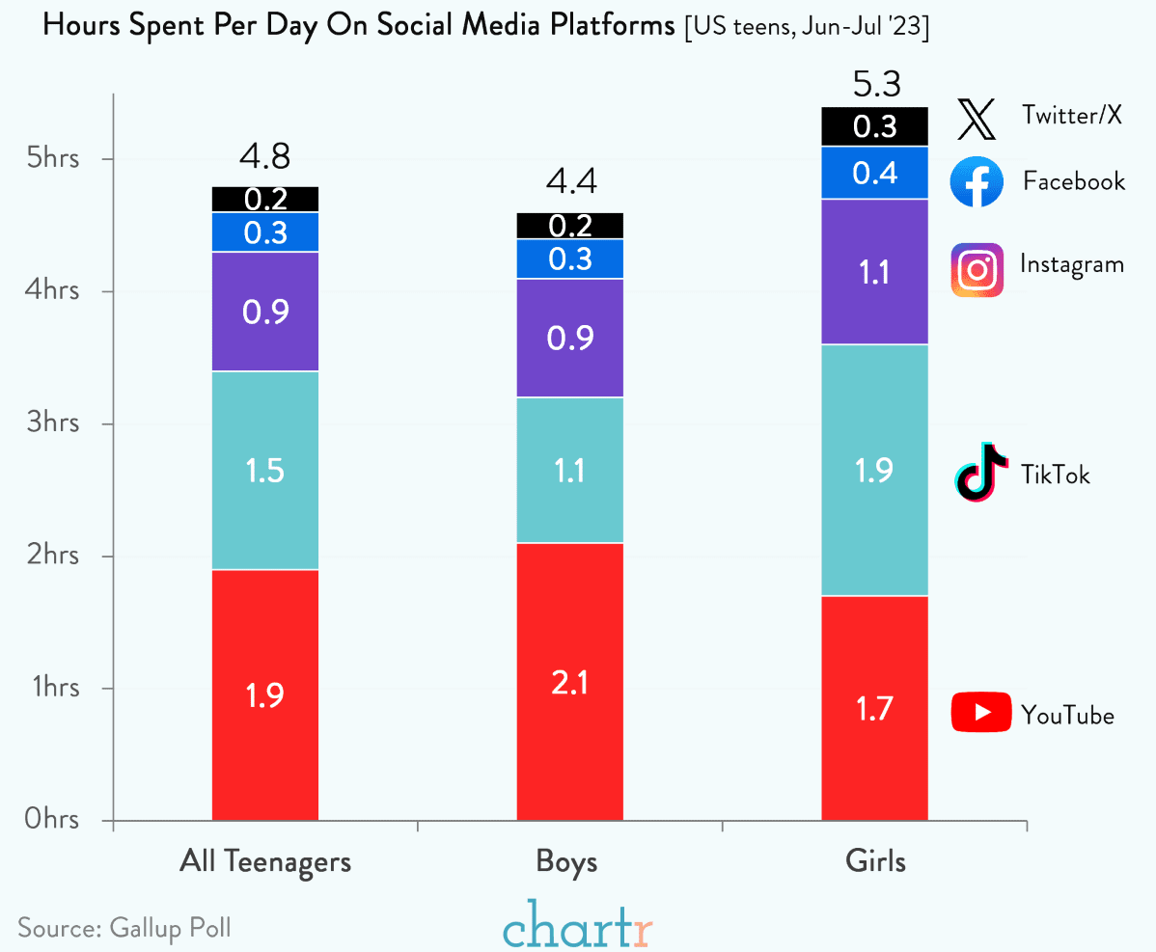
Screen Time!
Notes:
Another item that challenges our overall wellbeing is our screen time! This Gallop Poll from 2023 shows for teen boys and girls the amount of time spent online. YouTube and TikTok lead the way. Followed by Instagram, Facebook and Twitter/X. See anything here that surprises you?

Slide 12

Steps to Wellbeing
Connect with other people.
Be physically active.
Have healthy routines – day and night.
Balance activities & learn new skills.
Give to others.
Pay attention to the present moment.
Notes:
So when looking at our overall wellbeing and specifically for students, there are at least six steps we can take to help get us back on the pathway to living well. We’ll go over each of these in some detail.

Slide 13

Steps to Wellbeing
Connecting with Others
A.S.K. Model for Connecting:
Acknowledge: Let them know their feelings and experiences are valid, that you believe them and recognize the courage it took to come to you.
Support: Show up and ask how you can help. Offer options and resources for coping methods and/or professional help if needed.
Keep-In-Touch: Actions speak louder - checking back in regularly shows you really care about and hear them
Source: MTV Entertainment | https://www.mentalhealthishealth.us/
Notes:
The first step is looking at how we connect with others. There’s a recently released program developed by MTV and Active minds called ASK. It is meant to help and empower youth and young adults to simply and effectively help people connect and work through their challenges. You can see on the screen, ASK stands for Acknowledge, Support, and Keep in Touch. Can you give me an example of a situation when you might have recently worked through any of ASK with a friend or someone else?

Slide 14
Steps to Wellbeing
Be Physically Active
Being active is not only great for your physical health and fitness, but also for mental health.
  Helps improve self-esteem.
  Helps with goal setting/challenges/accomplishments.
  Leads to healthier brain chemical activity and can help positively change mood.
How to be physically active?
Walking, hiking – 10,000 step challenge.
Biking, swimming, running, dancing, etc., apps can help track progress.
Check out local community recreational activities.
Daily exercise routines.
Notes:
A second step to wellbeing, is being physically active. Being physically active everyday helps our self-esteem and mental health, as well as our overall physical well-being. It can be as simple as walking for 30 minutes or more a day, or biking, swimming, running. Many use an app to track their progress! A key is to have a set plan and schedule physical activity into your daily schedule. What are some barriers for you to being physically active? What could you do different?

Slide 15
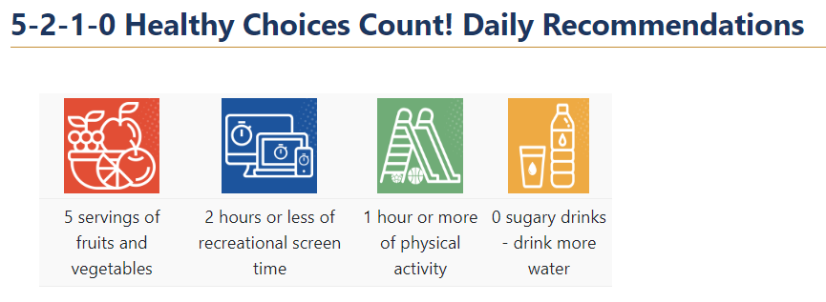
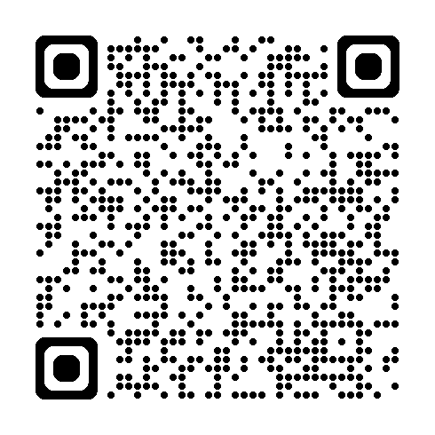
Steps to Wellbeing
Healthy routines | Day & Night
Build healthy routines for yourself during the day and evening.
Meals
Exercise
Bed-time
Wake time
Friend time
Screen time
School time
Down time
Rest time
Notes:
A third step, is setting up health routines. You can see quite a list on the screen of where we can build health routines for ourselves. There’s an HHS p
5-2-1-0 Healthy Choices Count!—a public-private partnership—cultivates healthy places for Iowa children and families using evidence-based healthy eating and active living approaches. Working together, Iowa HHS and the Healthiest State Initiative provide strategic leadership, stakeholder management, community funding, and evaluation to the initiative.rogram called 5-2-1-0 Health Choices Count!
What do you think of the Daily Recommendations listed? Where could you improve?

Slide 16
Steps to Wellbeing
Learning to cook or cook something new.
Taking on a new responsibility at school or at home.
Work on a do-it-yourself (DIY) project! YouTube can help!
New hobbies that challenge you, such as writing a blog or learning to paint.
Balancing Activities and Learning
Even if you feel like you do not have enough time, or you may not need to learn new things, there are many ways to bring learning into your life.
Notes:
Along with healthy routines, is balancing our activities and our learning. We are creatures of habit and learning. We learn our entire lives. How are you being creating to learn new things? Has anyone started up a now hobby or activity? What type of reading to you like to do?

Slide 17
Steps to Wellbeing
Give to Others
Acts of giving and kindness improve mental wellbeing
Creates positive feelings and a sense of reward.
Gives a feeling of purpose and self-worth.
Helps connect with other people.
Notes:
Another step important to our overall wellbeing is how we “give back” what has been given to us. Some may call this charity work or supporting a cause. This is all about giving back. Acts of kindess are good for our souls and can help us connect with others and help break down the barriers we may put up around who we do and don’t associate with.

Slide 18
Steps to Wellbeing
Give to Others
What does “giving” look like?
Small acts of kindness towards other people, or volunteering in your local community (larger!).
Saying thank you to someone for something they have done for you.
Asking friends, family or colleagues how they are and really listening to their answer.
Spending time with friends or relatives who need support or company.
Offering to help someone you know with a do-it-yourself (DIY) or work project.
Sharing your gifts (administration, compassion, literature, music, poetry, signing, sports, writing, etc.).
Notes:
So what are some ways that you give back? Can anyone give examples how they’ve paid forward?

Slide 19
Steps to Wellbeing
Pay Attention to the Present Moment | Mindfulness
Focus on Where You Are
Thinking too hard about what you are doing may make it worse. Feel the “pulse” of life.
Focus on the Present
It’s easy to get trapped in the past or future, causing worry.
Focus on Your Breathing
There’s no better way to get you back to the present.
Set attainable goals for success
Match the goal to your ability level.
Acceptance
Let the emotions being felt exist. It’s OK for me to feel this way.
Notice the new things!
This helps prevent going on “auto-pilot”. the world is always changing.
Source: The Art of Now | Psychology Today
Notes:
Being present in the moment and paying attention to all that is around us is another step for our overall wellbeing. Have any of you ever overthought a situation? How did that work out? Would anyone like to share about a time where they got caught up in worrying about a past or future event? Slow, intentional breathing is a good way to get ourselves centered. Let’s try this! Close your eyes, and breath in deeply with me . . . 1,2,3,4,5 . . . Now breath out slowly, 1,2,3,4,5. Let’s do it again.
Setting attainable goals is also helpful. Would anyone like to share about goals they’ve set for themselves this year?
“Being With” our feelings. There are no “good or bad” feelings, just our feelings. It’s totally OK to have the feelings you have. Talk about them. YLI is a good place to talk about what might be going on and the feelings that you are having. You can also reach out to your friends, parents, youth leader, pastor or other trusted adult.
Lastly, notice and celebrate the new things going on around you. It’s so easy to get caught up in our routines that we fail stop and be present in the moment, notice the sky, the birds, the trees, the water and more.

Slide 20
Checking our Talk
Person First Language
Recommended Language to Use | Language to Avoid or Use with Caution | Why?
Substance Use | Substance Abuse | The term "abuse" is associated with criminal activity (i.e., domestic abuse, child abuse).
Person with substance use disorder or challenge | Addict, Junkie, Abuser, Druggie, User | People cannot and should not be defined by one behavior or characteristic. The person should always come first to avoid stereotypes and stigma. "Substance use disorder" should not be used interchangeable with "substance use." Not everyone who uses substances has a substance use disorder.
Person with alcohol use disorder | Alcoholic, Drunk | People cannot and should not be defined by one behavior or characteristic. The person should always come first to avoid stereotypes and stigma. "Substance use disorder" should not be used interchangeable with "substance use." Not everyone who uses substances has a substance use disorder.
Substance free No longer using _____ | Clean | The terms “dirty” and “clean” are adjectives used to describe filth or the lack thereof. They further negative stereotypes.
Notes:
Being aware how we talk about others is also important for our and other’s overall wellbeing. It’s a hard step. We have different growing up experiences, family dynamics, social perspectives, activities, and in some cases trauma. These all shape who we are and how others might view us. One of the ways to check our talk is to remember to be respectful of others, no matter what their believes or ideologies might be. At the core, we are all humans! Labels are easy for us to throw around forgetting the harm they may cause ourselves or others. On this slide are a few examples of labels to avoid using around substance use and alternative language to use.
What other labels do you use when talking about others?

Slide 21
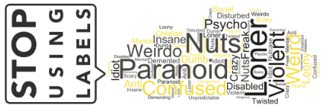
Check our Talk
What can we do?
Know the facts. Educate yourself about behavioral health.
Beware of your own attitudes and behavior. Examine your own judgmental thinking. Reinforced by your upbringing and society.
Choose your words carefully. The way we speak can affect the attitudes of others.
Educate others. Pass on the facts and positive attitudes; challenge myths and stereotypes.
Notes:
Here are a couple of steps we can take in reminding us and others to “Check our Talk”. What are examples on how we can check our talk?

Slide 22
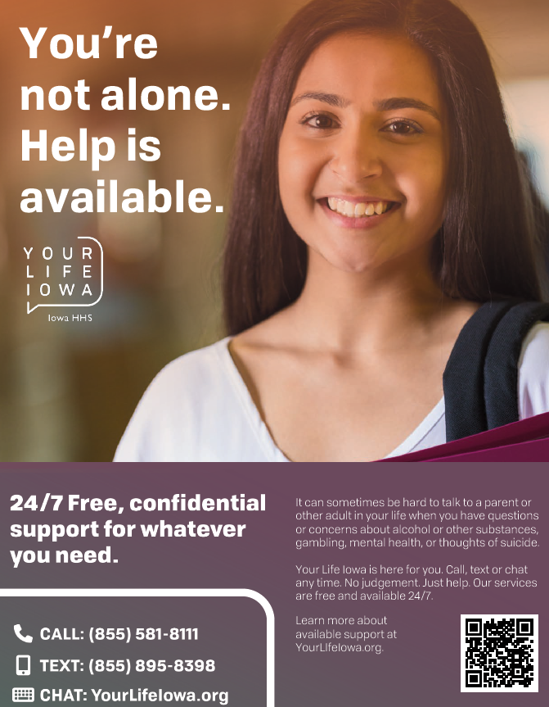
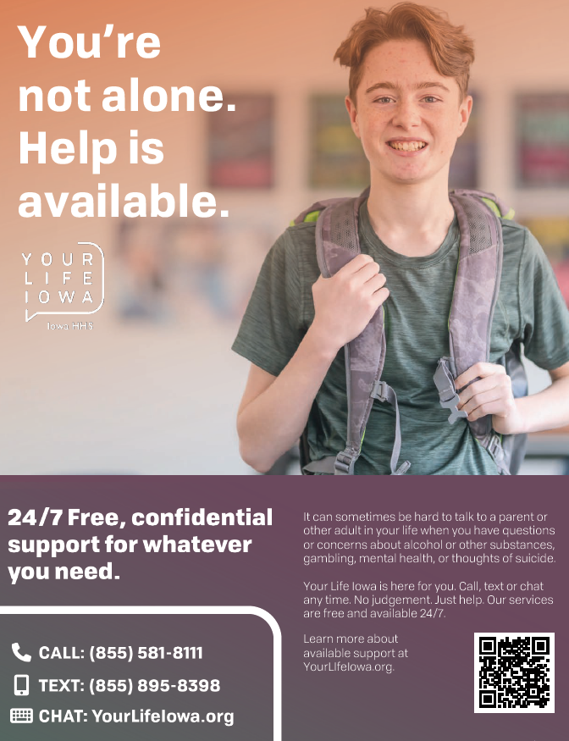
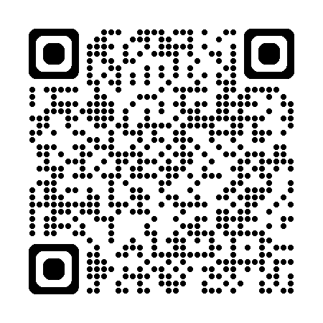
How YLI Can Help!
Help for Teens
Help For Teens Video
https://youtu.be/3X8FgxX48Vc
Notes:
Lastly, before getting to questions, YLI has a special section on the YLI website specifically for teens. YLI is here for you! The Help for Teens section of the website has lots of helpful information available 24/7. You can also reach out by calling, texting or chatting online. It’s free and confidential. They will listen. No judgement. Whether you have questions about what’s going on in your life, or about a friend or parent. YLI is here for you.

Slide 23
Questions?
Notes:
Does anyone have any questions?

Slide 24
[Your Name]
[Your Company Name}
[email address] yli@hhs.iowa.gov
Notes:
Thank you again for the opportunity to be with you today. I hope that each of you will take something away from the presentation to help you with your overall wellbeing and relationships at school and home. Here’s is my contact information if you’d lie to get a hold of me, as well as the contact information for YLI. Thank you!

